Slide 1

Instance Segmentation and Object Detection in Autonomous Driving
Zhonggang Li, Zichen Qiu, Jiun-Ting Chen, Yimiao Cao
Notes:
Good morning everyone, my name is Yimiao,
Today I will be presenting the project our team works this semester instance segmentation and object detection in autonomous driving

Slide 2
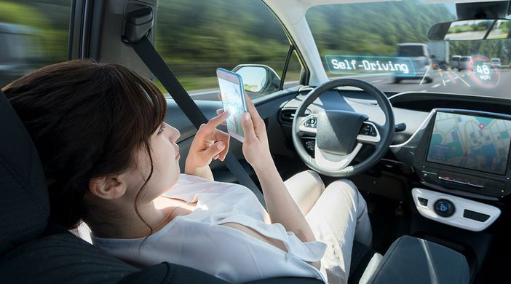
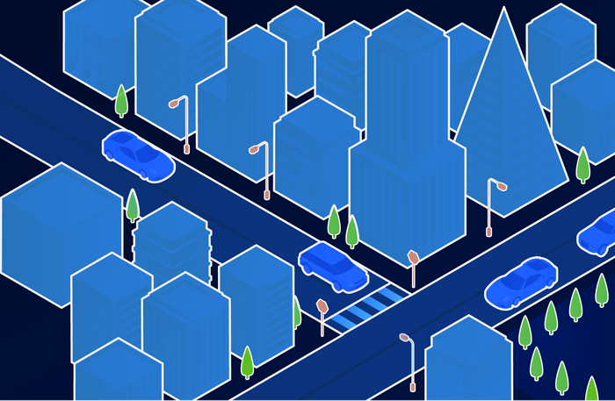
Motivation
Self-driving cars are the future.
Implementing autonomous cars will allow for accurate and safer transportation.
Notes:
Self-driving cars are the future. An autonomous vehicle needs sensory input devices like cameras, radar and lasers to allow the car to perceive the world around it
If we can improve object detection greatly, we’ll be one step closer to self-driving cars and a safer and more convenient future.

Slide 3
Problem Statement
Deep learning has considerably improved semantic image segmentation
However, its high accuracy is traded against larger computational costs which makes it unsuitable for embedded devices in self-driving cars
In this project, we explored different models for image segmentation and tried to find a deep network architecture that keeps the high accuracy while being efficient enough for detecting driving cars

Slide 4
Part 1: Current State-Of-Art
Notes:
Let me first introduce several models we used in our project.

Slide 5
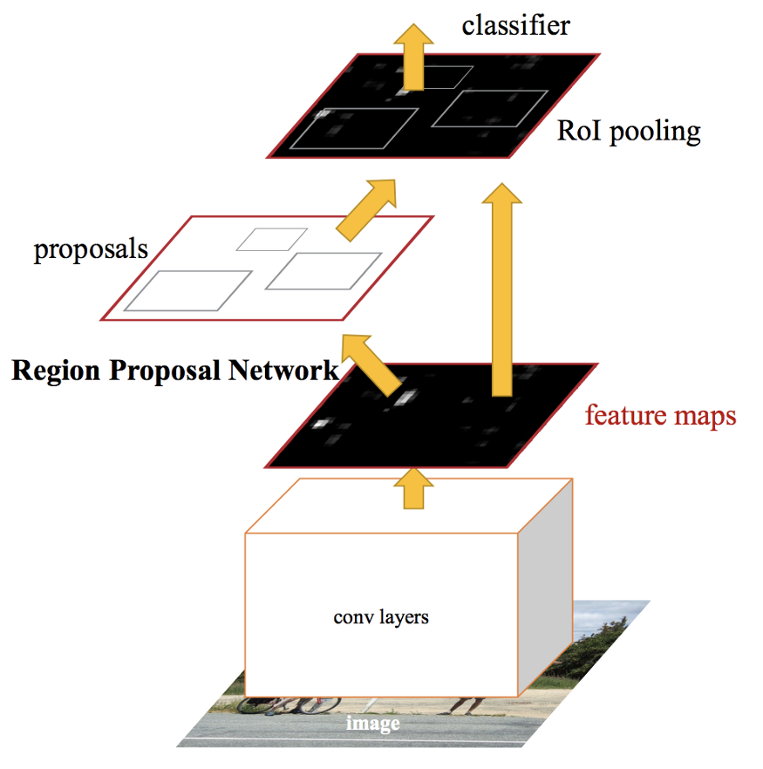
Faster-RCNN
(RPN + Fast R-CNN)
An object detection architecture
Faster R-CNN models can be faster if we limit the number of regions proposed
Rol Pooling has some quantization operations
These quantizations introduces misalignments between the Rol and the extracted features
It can have a negative effect on predicting bounding box
Notes:
Faster R-CNN consists of two modules. The first module is a deep fully convolutional network that proposes regions, and the second module is the Fast R-CNN detector that uses the proposed regions. The primary differentiator for Faster R-CNN is the RPN which is inserted after the last convolutional layer.

Slide 6
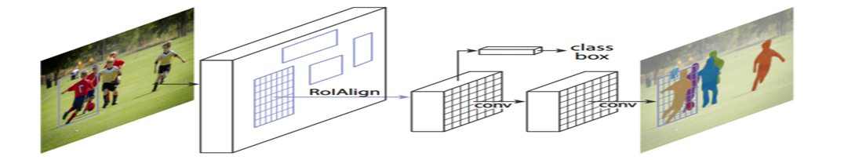
Mask-rCNN
Mask RCNN extends Faster R-CNN by adding a branch for predicting segmentation mask on each regions of interest(Rol), in parallel with the existing branch for classification and bounding box regression
Notes:
We can extend such techniques to locate the pixel of the image instead of just bounding boxes and generate the precise segmentation, which is the model called mask rcnn

Slide 7
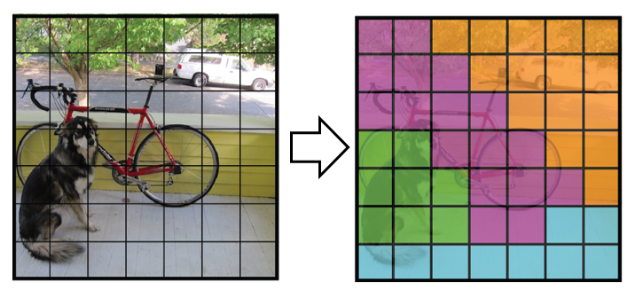
YOLO-You Only Look Once
a single convolutional network simultaneously predicts multiple bounding boxes and class probabilities for those boxes.
Extremely fast and accurate
Notes:
Another model we want to introduce is called YOLO, Also Known as You Only Look Once, which is one of the most powerful real-time object detector algorithms. It is called that way because unlike previous object detector algorithms, like R-CNN or its upgrade Faster R-CNN it only needs the image (or video) to pass one time through its network.

Slide 8
Part 2: Our Methodology
Notes:
Let’s take a look at our dataset before looking at our methodology.

Slide 9

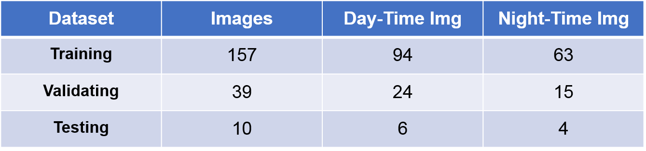
Dataset
Our dataset comes from Berkeley’s BDD 100K self-driving dataset
It consists of over 100K video sequences with diverse kinds of annotations including image-level tagging, object bounding boxes, drivable areas, lane markings, and full-frame instance segmentation
Notes:
We introduce a training, a validation and a test test, containing 157, 39 and 10 images. We also split data into day-time images and night-time images

Slide 10
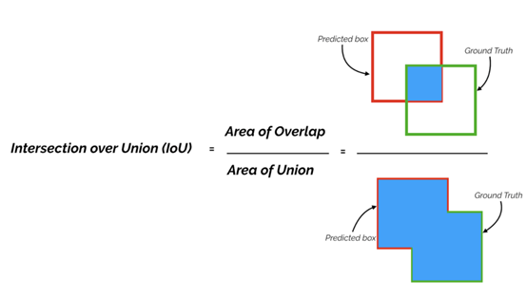
Evaluation Metrics
In this project, we focus on two performance evaluation metrics: Running time and mAP
Running time
Evaluate the computation efficiency and computation costs
mAP
Evaluate the model accuracy
The mean Average Precision is calculated by taking the average of AP over all classes and/or over all Intersection over Union (IoU) thresholds.

Slide 11
Implementation Details and Issues Resolved
Step 1: Training the DataSet
First model: Mask-RCNN
Instead of training the new model from scratch, we started from pre-trained COCO weights
Step 2: Loading the Dataset
To handle different input formats, our implementation provides several python files that helps to collect images and do the json conversion
Step 3: Making the prediction and verifying the result
To verify that our model gets a better result than the COCO model, we visualized the masks and bounding boxes and calculated mAP values for both models
Step 4: Investigating the effect of brightness of images and day-versus nighttime onto our models predictions
Step 5: Looking into faster R-CNN and Yolo models and repeat the similar process
Training the mask R-CNN is super slow
Annotations and selected images have a huge impact on the result
Decided to deploy the images with the TensorFlow on multiple GPUs!
Device | 5 steps x 1 epochs | 10 steps x 10 epochs | 1000 steps x 30 epochs
CPU | ~ 2 hours | ~ 8 hours | > 72 hours
GPU | ~ 1 hour | ~ 1 hour | ~ 4 hours
Notes:
Step 2: In the end, the annotation will be saved in a JSON file and each mask is a set of polygon points.
Training the mask R-cnn is slow: the mask R-CNN is simple and flexible, however, the training process is computationally expensive and time-consuming. To speed up the work, we experimented with various techniques trying to achieve the fast training time. After many iterations of trials and rectification, we decided to deploy the images with the TensorFlow on multiple GPUs. The time for training has sharply dropped from several days to a few hours only!
Annotations and selected images have a huge impact on the result: we found that the ways we selected and annotated the images had a significant impact on the prediction accuracy. We must be careful in picking our images that best suit the project goal and we may also need to refer to more papers and optimize the accuracy and stability of the new model.

Slide 12
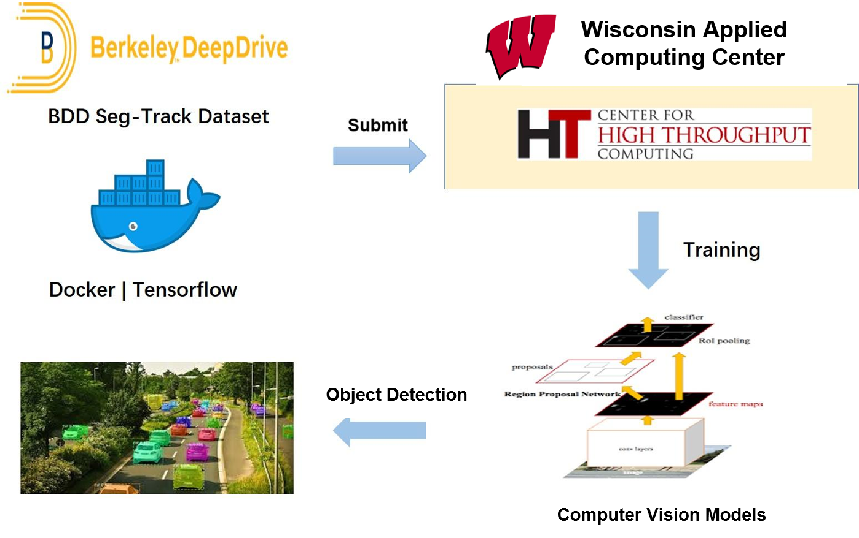
Workflow
Notes:
In our study, we submitted our jobs to Euler cluster (WACC Computational Infrastructure) and CHTC's high-throughput computing servers. We further set and fixed our configurations by anaconda (conda create) and docker image

Slide 13
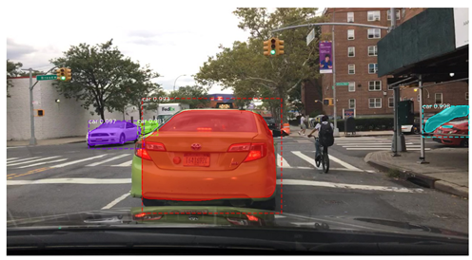
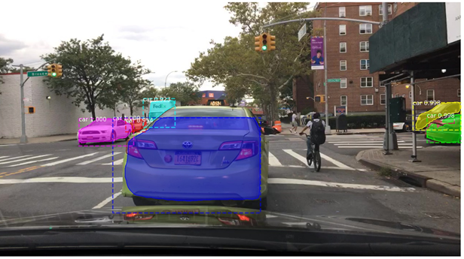
Result - Train with new processed data: better performance
Pre-Trained Model
New Data-Trained Model
Notes:
We started our training using pre-weight based on COCO model and found that. The mAP based on the validation dataset for COCO model is only 0.4024. Thus we decided to train a new model to achieve better performance for our Mask-RCNN model.
Next, we added 200 images from the BDD datasets. Considering the model performance and time consuming, we chose to run 1000 steps x 30 epochs. After adding new training data, the model performs better, From above images, we can see (a) COCO model fails to detect the fedex trunk while on the right hand side, our trained model is able to detect it correctly

Slide 14
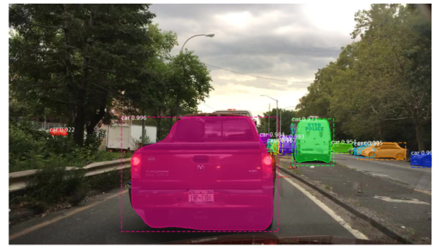
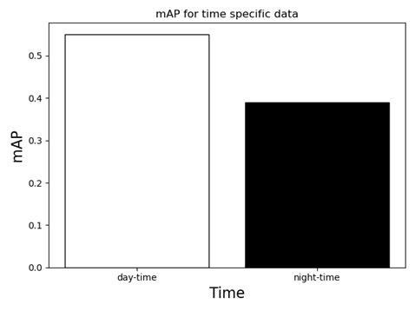
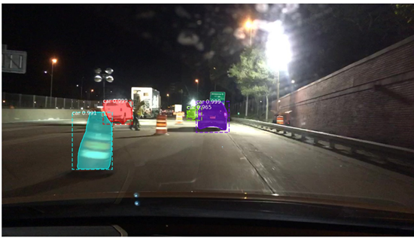
Result-mAP varies for day-time and night time
Based on our optimized Mask-RCNN model, day-time mAP is as high as 0.54 but night-time mAP is only 0.38.
Notes:
In the next step, we split our validation dataset into two groups, day-time group and night-time group. Not surprisingly, we found that the difference of mAP between two groups is huge(0.54 vs 0.38), which might be due to lighting and resolution at night

Slide 15
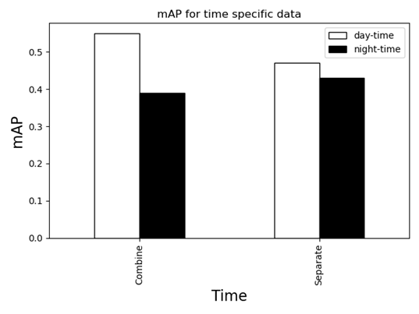
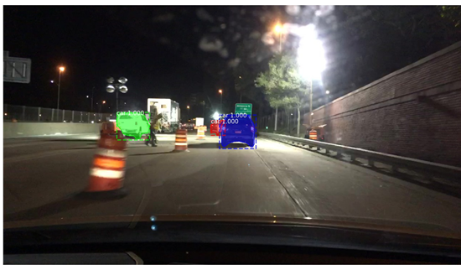
Result-Training model separately improves segmentation accuracy for night images
Notes:
Then we split the training data into day-time and night-time groups and train our Mask-RCNN model separately. This strategy, although slightly increased the mAP for night-time images, decreased the day-time images segmentation accuracy, which might be due to the relatively small of our dataset and shrink of the total images number in the separate training process

Slide 16
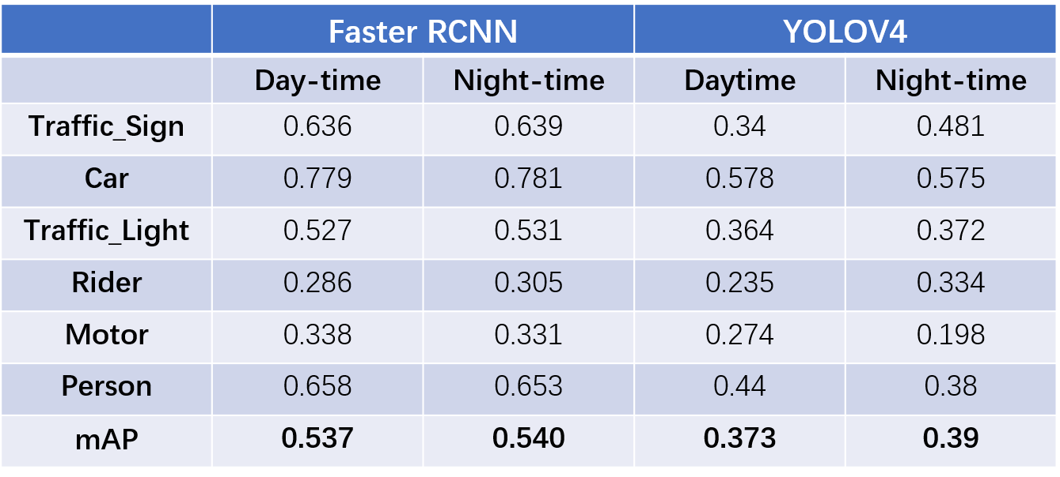
Result-Object Detection Results Using YOLOV4 and Faster-RCNN
Notes:
We used the similar process to train the yolov4 and faster-rcnn and found that faster-rcnn gives us better accuracy in object detection while yolo v4 is more efficient in training.

Slide 17
Part 3: Conclusion and Future Work

Slide 18
Conclusion and Future Work
Neural networks are trained on servers or workstations with powerful GPUs, and these GPU systems are subsequently used for inference on new data. However, a self-driving car needs to react to new events instantly to guarantee the safety of passengers and other traffic participants
Future work
Look into dataset augmentation to see if the performance could be even better
Do more model tuning or modify the model structure to gain better performance(remove further processing units or replace the pooling units with other design)
We cannot precisely compare the time consumed each model since the traffic of the server varied and the hardware specification among servers is not the same. It would be better that we’re able to find out a low peak period to get related metrics to evaluate.

Slide 19
Q&A
Notes:
That’s all. Thank you for your listening!

